Slide 1
Multiple Choice Questions
Functions
&
Storage Classes
Prepared by:
Mehak(23837)
SEEE-CSE

Slide 2
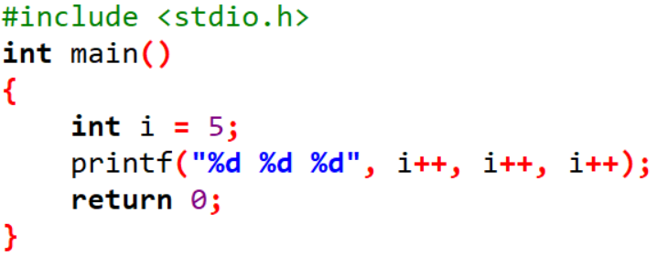
1. Output of following program?
A. | 7 6 5
B. | 5 6 7
C. | 7 7 7
D. | Compiler Dependent
Solution: D
When parameters are passed to a function, the value of every parameter is evaluated before being passed to the function.
If evaluation order is left-to-right, then output should be 5 6 7 and if the evaluation order is right-to-left, then output should be 7 6 5. Unfortunately, there is no fixed order defined by C standard. A compiler may choose to evaluate either from left-to-right. So the output is compiler dependent.

Slide 3
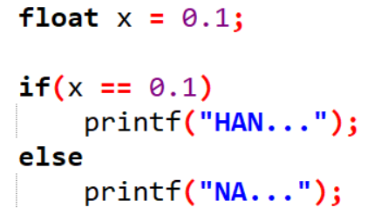
2. Find output:
a) NA…
b) HAN…
c) Run time error
d) Compile time error
Solution: A
Here, x = 0.10000
Thus, x ≠ 0.1

Slide 4
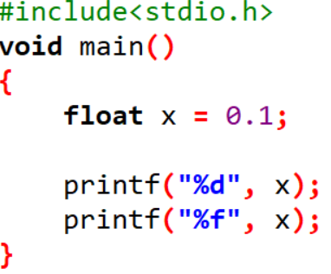
3. Find output:
a) 0.100000, junk value
b) Junk value, 0.100000
c) 0, 0.100000
d) 0, 0.999999
Solution: B

Slide 5
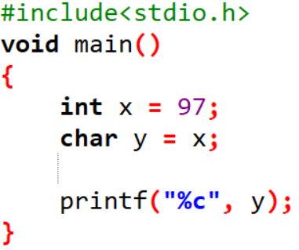
4. What will be the output of the following C code?
a) a
b) A
c) 97
d) Run time error
Solution: A

Slide 6
5. In C, parameters are always
A. | Passed by value
B. | Passed by reference
C. | Non-pointer variables are passed by value and pointers are passed by reference
D. | Passed by value result
Solution: A
In C, function parameters are always passed by value. Pass-by-reference is simulated in C by explicitly passing pointer values.

Slide 7
6. Which of the following is true about return type of functions in C?
A. | Functions can return any type
B. | Functions can return any type except array and functions
C. | Functions can return any type except array, functions and union
D. | Functions can return any type except array, functions, function pointer and union
Solution: B
functions can return any type except arrays and functions. We can get around this limitation by returning pointer to array or pointer to function.

Slide 8
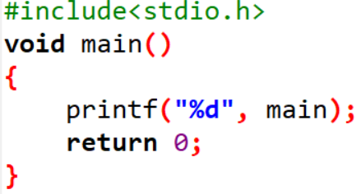
7. Find output:
A | Address of main function
B | Compiler Error
C | Runtime Error
D | Some random value
Solution: A
Name of the function is actually a pointer variable to the function and prints the address of the function

Slide 9
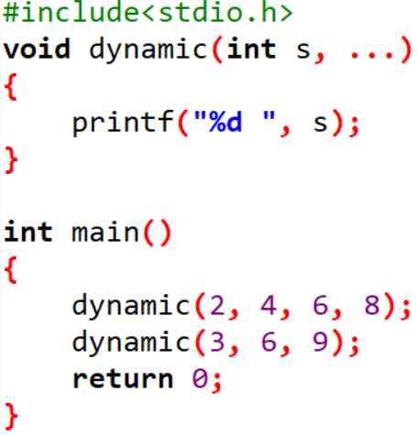
8. Find output:
A. | 2 3
B. | Compiler Error
C. | 4 3
D. | 3 2
Solution: A
In c three continuous dots is known as ellipsis which is variable number of arguments of function. The values to parameters are assigned one by one. Now the question is how to access other arguments.

Slide 10
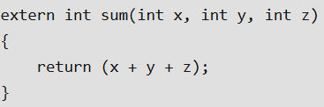
9. What is the meaning of using extern before function declaration? For example following function sum is made extern
Solution: B
extern keyword is used for global variables. Functions are global anyways, so adding extern doesn't add anything.
A. | Function is made globally available
B. | extern means nothing, sum() is same without extern keyword.
C. | Function need not to be declared before its use
D. | Function is made local to the file

Slide 11
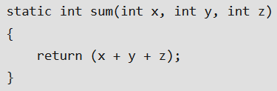
10. What is the meaning of using static before function declaration? For example following function sum is made static
A. | Static means nothing, sum() is same without static keyword.
B. | Function need not to be declared before its use
C. | Access to static functions is restricted to the file where they are declared
D. | None of these
Solution: C
functions are global by default. Unlike global functions, access to static functions is restricted to the file where they are declared.

Slide 12
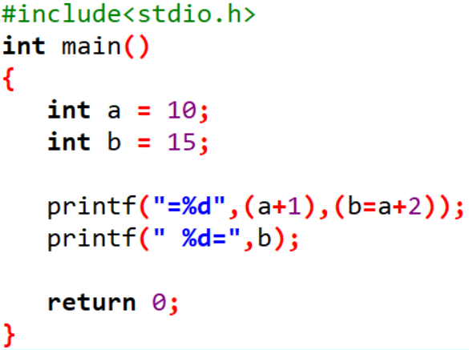
11. What’s going to happen when we compile and run the following C program snippet?
A. | =11 15=
B. | =11 12=
C. | Compiler Error due to (b=a+2) in the first printf().
D. | No compile error but output would be =11 X= where X would depend on compiler implementation.
Solution: B
As per C standard C11, all the arguments of printf() are evaluated irrespective of whether they get printed or not. That’s why (b=a+2) would also be evaluated and value of b would be 12 after first printf(). That’s why correct answer is B.

Slide 13
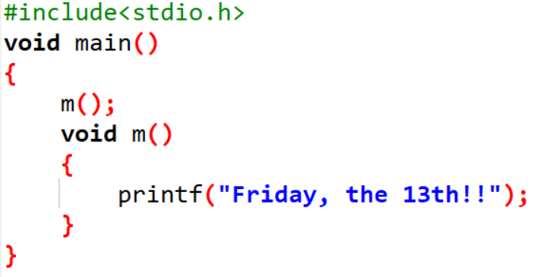
12. What will be the output of the following C code?
a) Friday, the 13th!!
b) Compile time error
c) Nothing
d) Varies
Solution: B

Slide 14
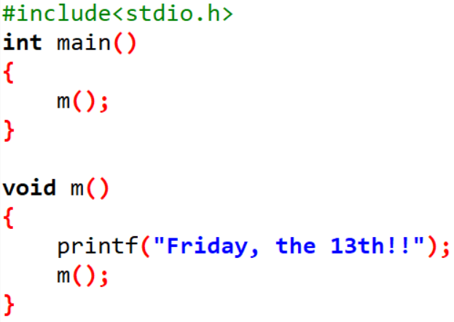
13. What will be the output of the following C code?
a) Compile time error
b) Friday, the 13th!!
c) Infinite Friday, the 13th!!
d) Nothing
Solution: C

Slide 15
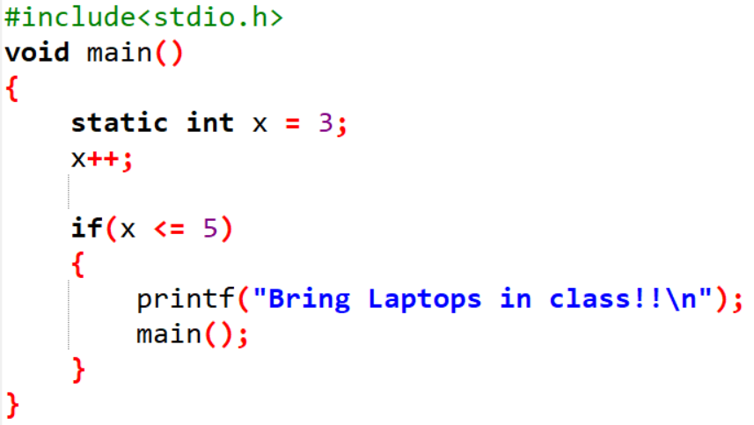
14 What will be the output of the following C code?
Run time error
Bring Laptops in class!!
Bring Laptops in class!!
Bring Laptops in class!!
c) Infinite Bring Laptops in class!!
d) Bring Laptops in class!!
Bring Laptops in class!!
Solution: D

Slide 16
15. Which of the following is a correct format for declaration of function?
a) return-type function-name(argument type);
b) return-type function-name(argument type){}
c) return-type (argument type)function-name;
d) all of the mentioned
Solution: A

Slide 17
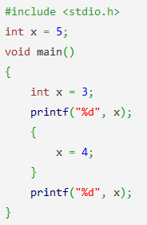
16. What will be the output of the following C code?
a) Run time error
b) 3 3
c) 3 5
d) 3 4
Solution: D

Slide 18
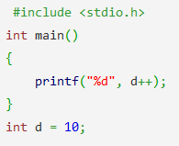
17. What will be the output of the following C code?
a) 9
b) 10
c) 11
d) Compile time error
Solution: D

Slide 19
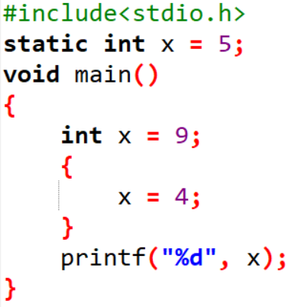
18. What will be the output of the following C code?
a) 9
b) 5
c) 4
d) 0
Solution: C

Slide 20
19. Automatic variables are allocated space in the form of a __________
a) stack
b) queue
c) priority queue
d) random
Solution: A

Slide 21
20. If storage class is not specified for a local variable, then the default class will be auto.
a) True
b) False
c) Depends on the standard
d) None of the mentioned
Solution: A

Slide 22
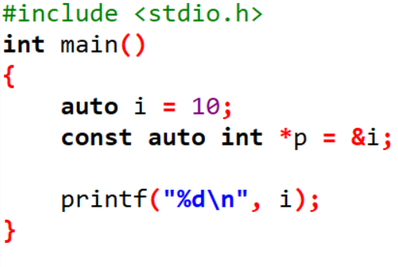
21. What will be the output of the following C code?
a) 10
b) Compile time error
c) Depends on the standard
d) Depends on the compiler
Solution: A

